Slide 1
What Happens When You Turn On Your Computer
CPU initializes and looks for firmware (BIOS/UEFI).
BIOS performs POST (Power-On Self Test).
Hardware components like RAM and devices are checked.
BIOS then searches for a bootable device.

Slide 2
Bootloader Process
BIOS loads the bootloader from the storage device.
Bootloader loads the Operating System kernel.
After kernel loads, the OS starts user-space programs.
Examples: GRUB (Linux), Bootmgr (Windows), boot.efi (MacOS).

Slide 3
32-bit vs 64-bit Operating System
Feature | 32-bit OS | 64-bit OS
Memory Addressing | 2^32 addresses (~4GB RAM) | 2^64 addresses (very large memory)
Register Size | 32-bit registers | 64-bit registers
Data Processing | Processes 4 bytes per cycle | Processes 8 bytes per cycle
Compatibility | Runs only 32-bit OS | Can run both 32-bit and 64-bit OS

Slide 4
Storage Devices in Computer System
Register – Smallest and fastest memory inside CPU.
Cache – Stores frequently used instructions and data.
Main Memory – RAM used for running programs.
Secondary Memory – Hard disk, SSD used for permanent storage.

Slide 5
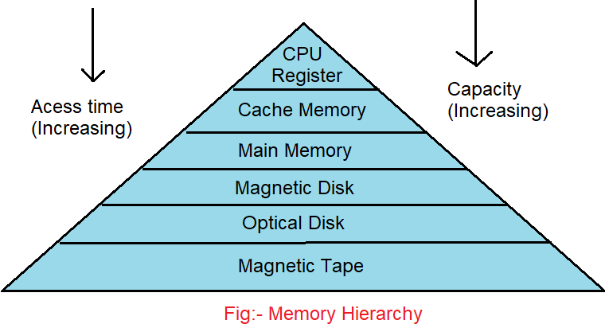
Memory Hierarchy (Storage Levels)

